Slide 1
COGNITIVE AUTOMATION IN EVALUATING COMPANY ASSOCIATES FOR APPRAISAL PROCESS
VIT Vellore_Team Strark
1. NSB Vamsee Krishna (Leader)
Email : nsbvamsee.krishna2019@vitstudent.ac.in
2. Andrew Moses
Email : andrew2moses@gmail.com
3. Muvvala Venkata Aravinda Satvik
Email : aravindsatvik@gmail.com

Slide 2
INTRODUCTION
Every company has hundreds of employees in each branch and it is necessary to evaluate every employee to identify the top performers.
Every company has this system called appraisal process where management will take certain parameters from every employee and choose the best ones to give salary hike or any other benefits.
The employee performance appraisal process is crucial for organizations to boost employee productivity and improve their outcomes.
So, it is necessary to record all the parameters like goals achieved by the associate, git code contribution, emails, attendance, time spent on calls etc by the HR manually.
But there is some bias that may be observed in this process which can be conscious or unconscious in which few worthy employees are not getting recognition to their work and are leaving the company to join in the competitor’s company which may incur loss to the company.
So it is necessary to overcome these problems and simplify the process of storing the record of every associate.

Slide 3
We are going to build an intelligent system which can be able to track all the necessary parameters to evaluate the employee.
This is beneficial in two ways. One is the bias will get reduced and the other is manual work of HR to measure these parameters which is hectic can be reduced.
These are some of the advantages of this intelligent system.
Minimized Attrition rate
Accurate assessment of diverse candidates
Overpaid or underpaid worker count
Increased pay transparency for employees
Employee productivity

Slide 4




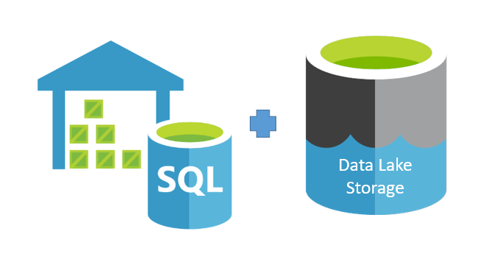




How we propose to solve!
1. Capture various contributions of an individual in an enterprise
Contribution on tracking tools
Documentation contribution
Code contribution
other unstructured involvement by parsing emails and raw text
time spent on calls / discussions
Attendance at meetups!
2. Both Structured and unstructured (raw text) are stored in a DB

Slide 5
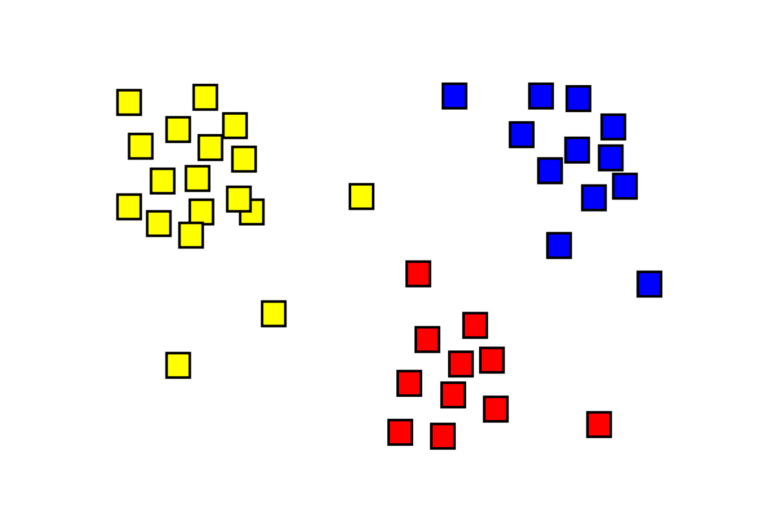

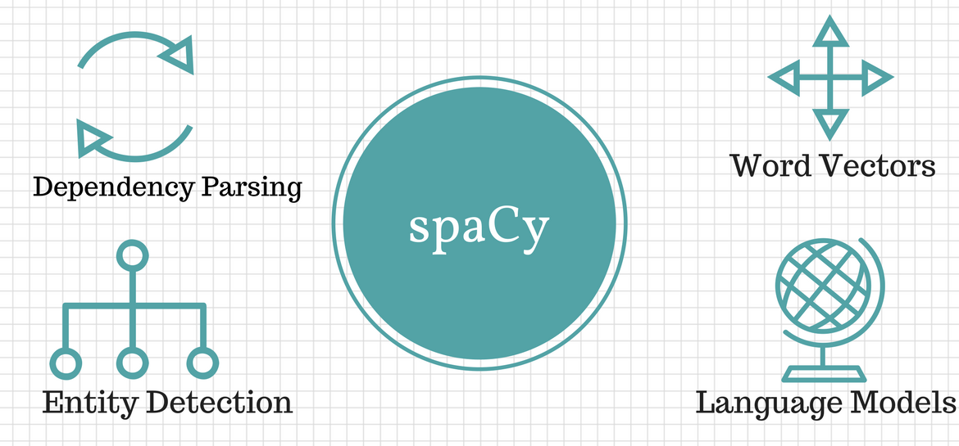
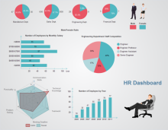
How we propose to solve!
3. Process unstructured data and come up with machine understand features
4. Clustering (unsupervised learning) to group associates.
5. Dashboard visualizing detailed content with varied parameters over time using the built model. Assisting decision makers

